Slide 1
Creating a Concise Resume by 第二組
林耕丞 賴和曦 劉中璇 陳思安 趙上惠

Slide 2
Resume Is Not an Autobiography
Can a hiring manager see my main credentials within 10 to 15 seconds?
Does critical information jump off page?
Do I effectively sell myself on the top quarter of the first page?

Slide 3
Decide what is crucial in the resume (key selling points).
Career summary statement
Use an editor eye.
The resume should not contain every detail.

Slide 4
Eight Tips to Keep Resume Concise
Avoiding repeating information.
Eliminate old experience.
Don’t include irrelevant information.
Cut down on job duties.
Remove “References available upon request.”
Use a telegraphic writing style.
Edit unnecessary words.
Customize your resume for your job target.

Slide 5
Education
The best placement depends on what things you try to emphasize.

Slide 6
Different Situations
EXAMPLE: ABC College -- Brooklyn, New York, BA in Communications, concentration in advertising, anticipated graduation December 2001 Senior Project: Currently completing mock advertising campaign for Coca-Cola (billboard/print/TV/radio ads, direct-mail campaign and press releases). Related Coursework: Advertising, Advertising Writing, Direct Mail and Telemarketing, Media Plans in Advertising, Marketing and Advertising, Public Relations, Broadcasting
Related work experiences
New grads
Degree incomplete
High school information
Lack of educational credentials
Professional Development Highlights: Product Launch in a Global Marketplace E-Commerce Solutions Selling the Dotcom Vision Increasing Sales Through Relationship Selling Professional Management Program
College of Staten Island -- Staten Island, New York, Completed 90 credits toward a BA in political science, 1981 to 1984
New Jersey College -- Newark, New Jersey, BS in Economics, Minor in Psychology, June 1983

Slide 7
GPA (Grade Point Average)
How to convert grades into GPA records
→ http://www.abups.com/com06.asp
Honor
Ace College -- Springfield, Illinois BA in Accounting (cum laude), June 2000 - Delta Gamma Delta Honor Society, Dean's List, GPA: 3.9

Slide 8

Top 10 resume blunders
971002035 賴和曦

Slide 9


1. Too focus on job duties
Don’t make a boring list
Focus on the achievement
My duties…
Study
Write papers
Take exams
Go to class

Slide 10

2. Flowery or general objective statement
Be specific and precise
Otherwise it is confusing
“A challenging position enabling me to contribute to organizational goals while offering an opportunity for growth and advancement”

Slide 11

3. Too long or too short
Too much
irrelevant info
Too long
Too short
Miss something
helpful

Slide 12
4. Using personal pronouns and articles
Business document for business communication
Make it concise and telegraphic (電報的)
“I successfully got the contract with SONY and therefore increased the gross of company’s profit by 25 %”
“Got the contract with SONY, and increased the gross of company’s profit by 25 %.”

Slide 13


5. Listing irrelevant information
Personal information the competency

Slide 14
6. Using a functional resume when you have a good career history
Functional format
Chronological format
Example:
http://www.resumeedge.com/contentpartners/resume198.shtml
Example:
http://www.resumeedge.com/contentpartners/resume214a.shtml

Slide 15
7. Not using a summary section that makes an initial hard sell
“Hard sell” (n) : a method of advertising or selling that is direct, forceful, and insistent
Create a summary statement that first determines what is important to the employer and then match your skills or experience with it

Slide 16

8. Where is the keywords?
Include relevant keywords in your resume
Shows you understand the requirement of the job
Makes your resume easier to be found

Slide 17

9. References available
Only use this statement to signal the end of a long resume or to round the design
Don’t make it the subject of your resume

Slide 18

10. Typos
Resume reflects you, make it perfect

Slide 19
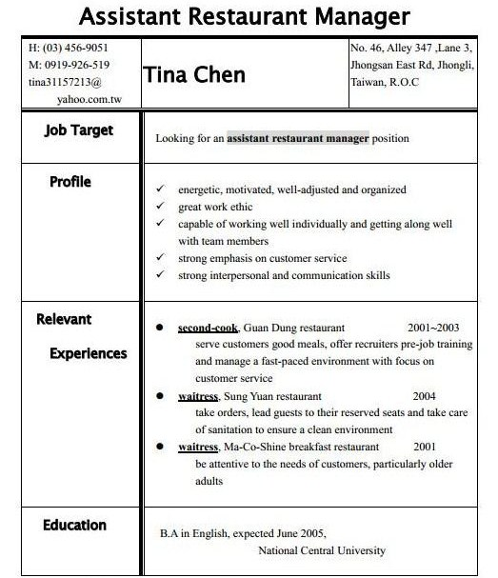
←Make sure you apply for the right job.
Bullet points of your personal strengths.
Your working experience is what the employers concern the most. So make it clear.
Education has little to do with this job application.

Slide 20
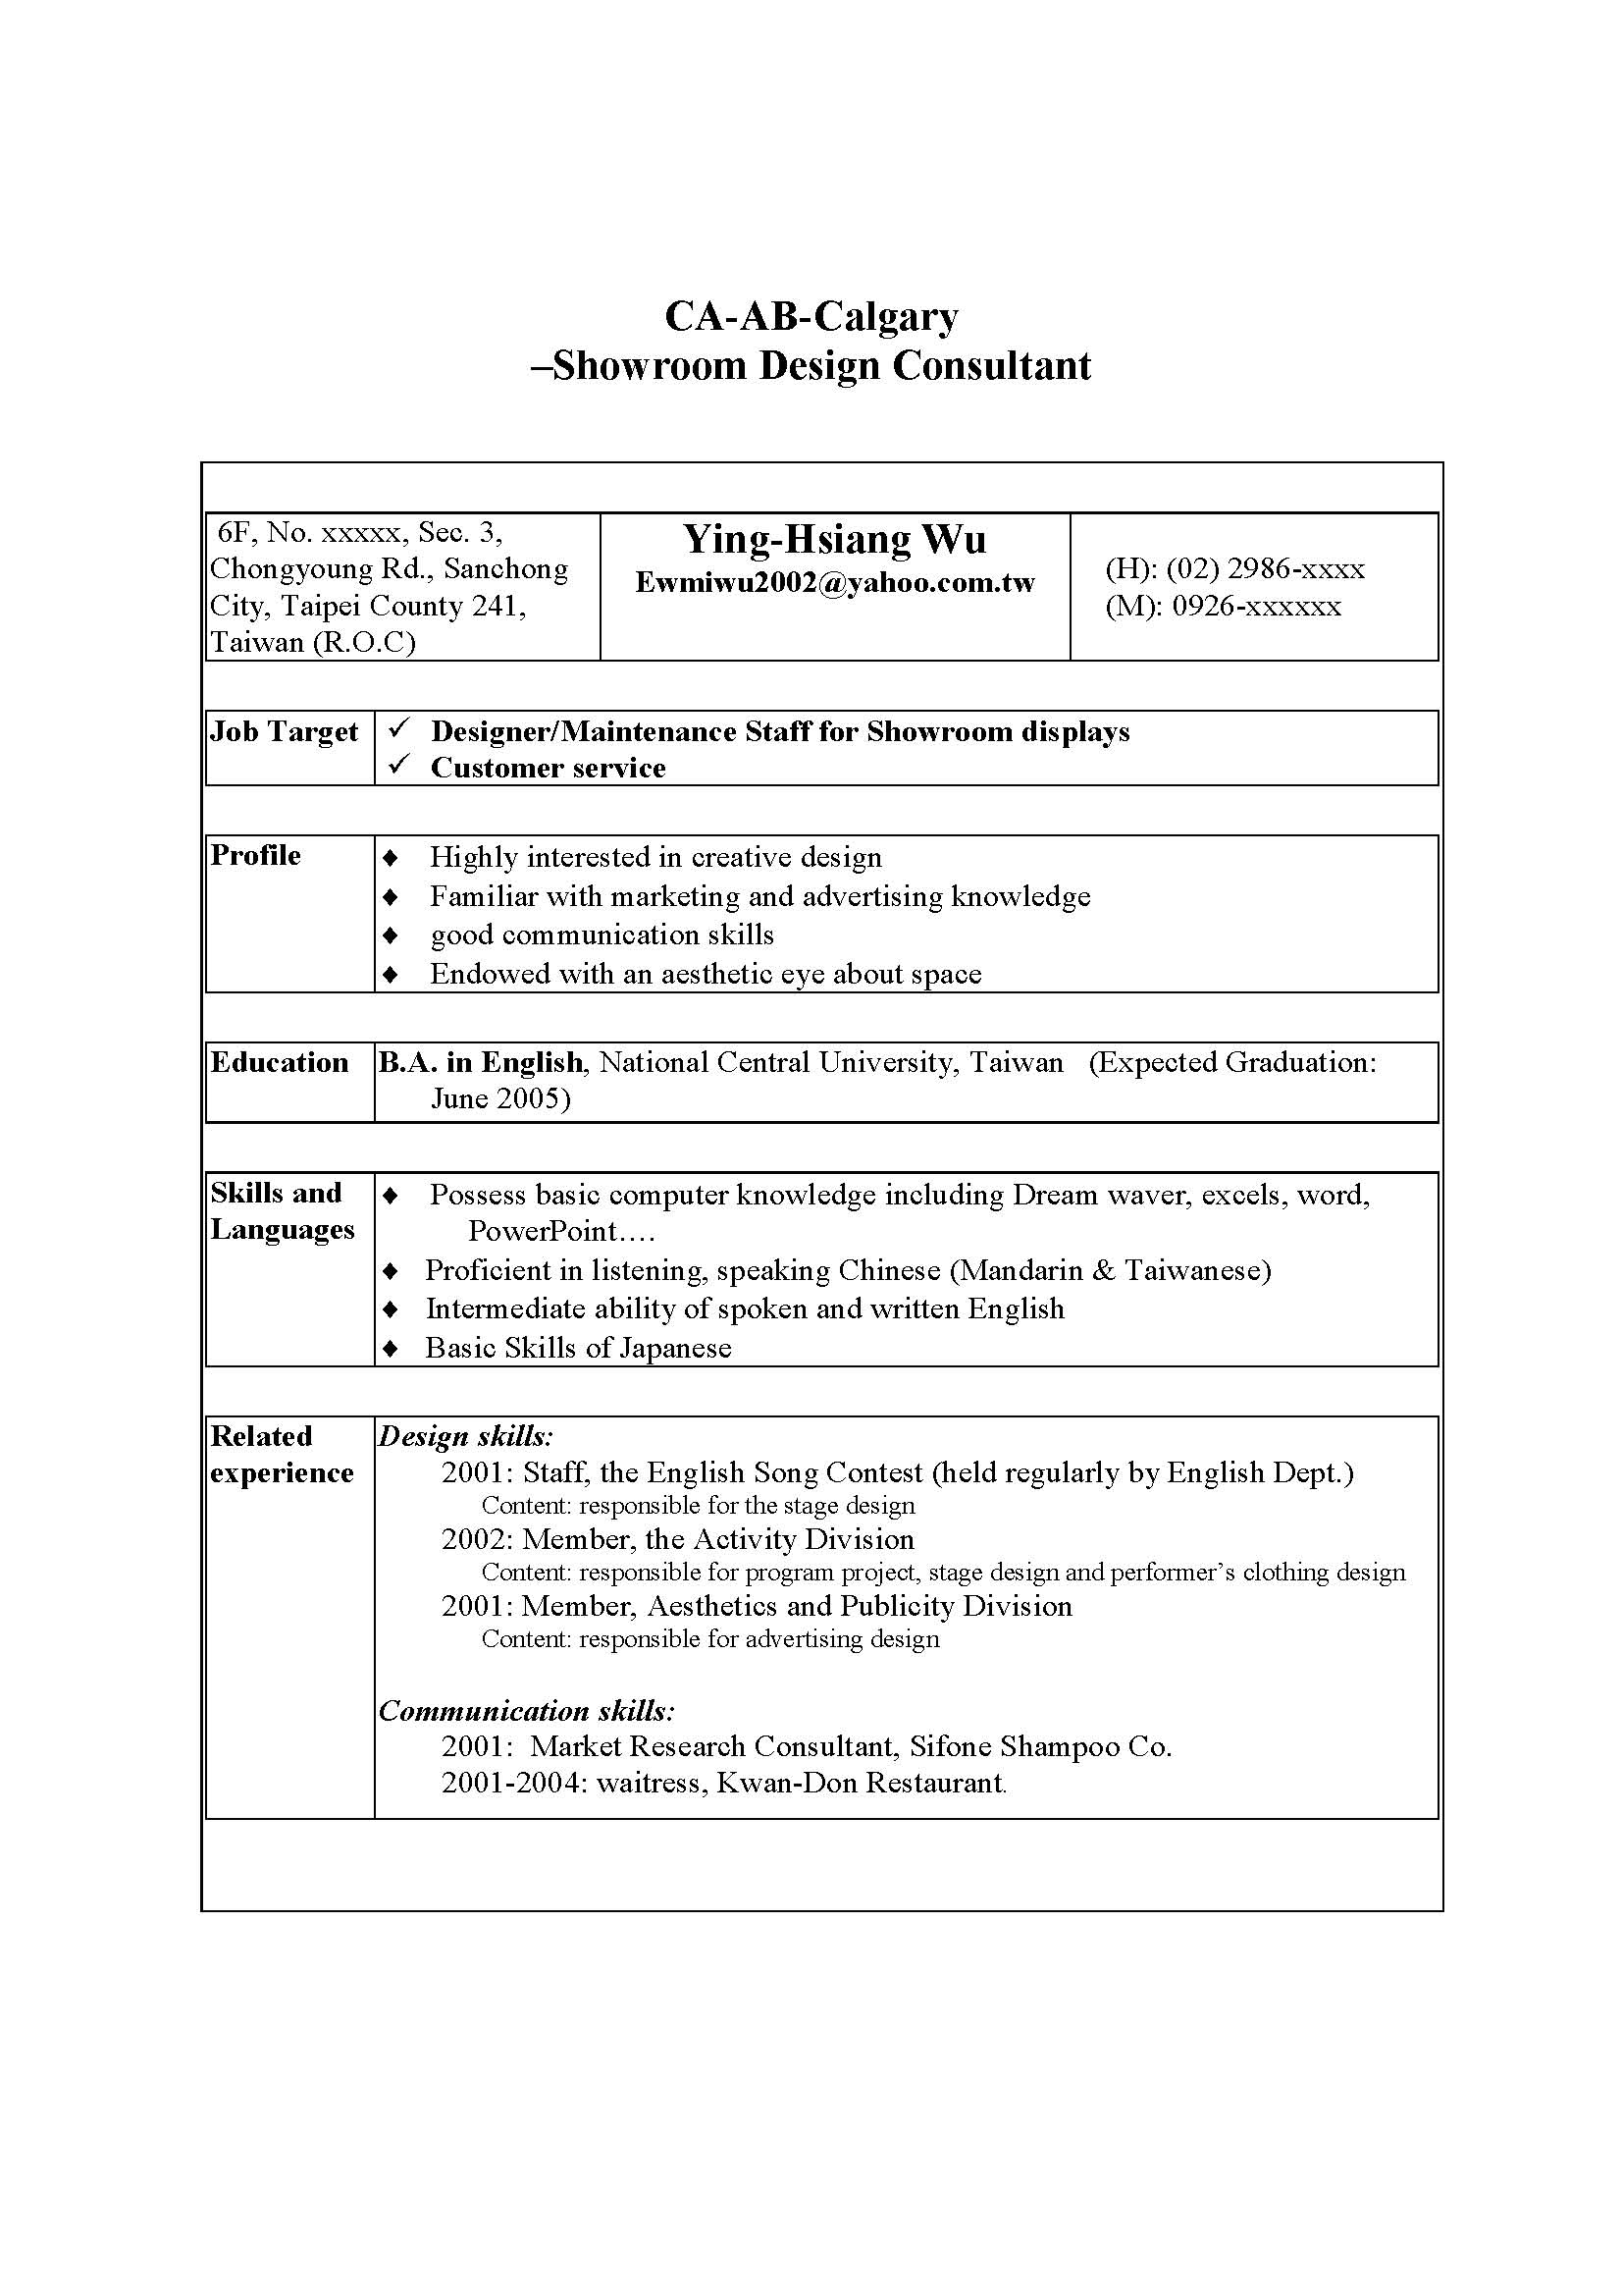
←If you are focusing more
on experience than education,
list the basic facts regarding your degree
→Bulleted list to
highlight your strengths

